Slide 1
Kubernetes
Why Kubernetes ?
What Kubernetes ?
How Kubernetes ?
By Emost Run Team

Slide 2
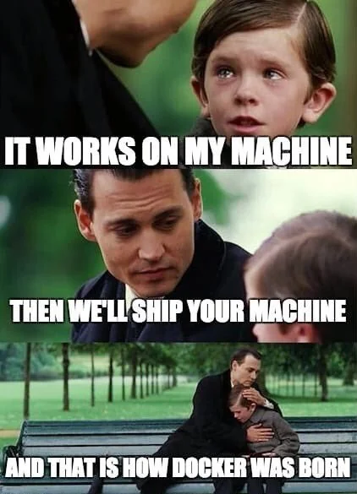
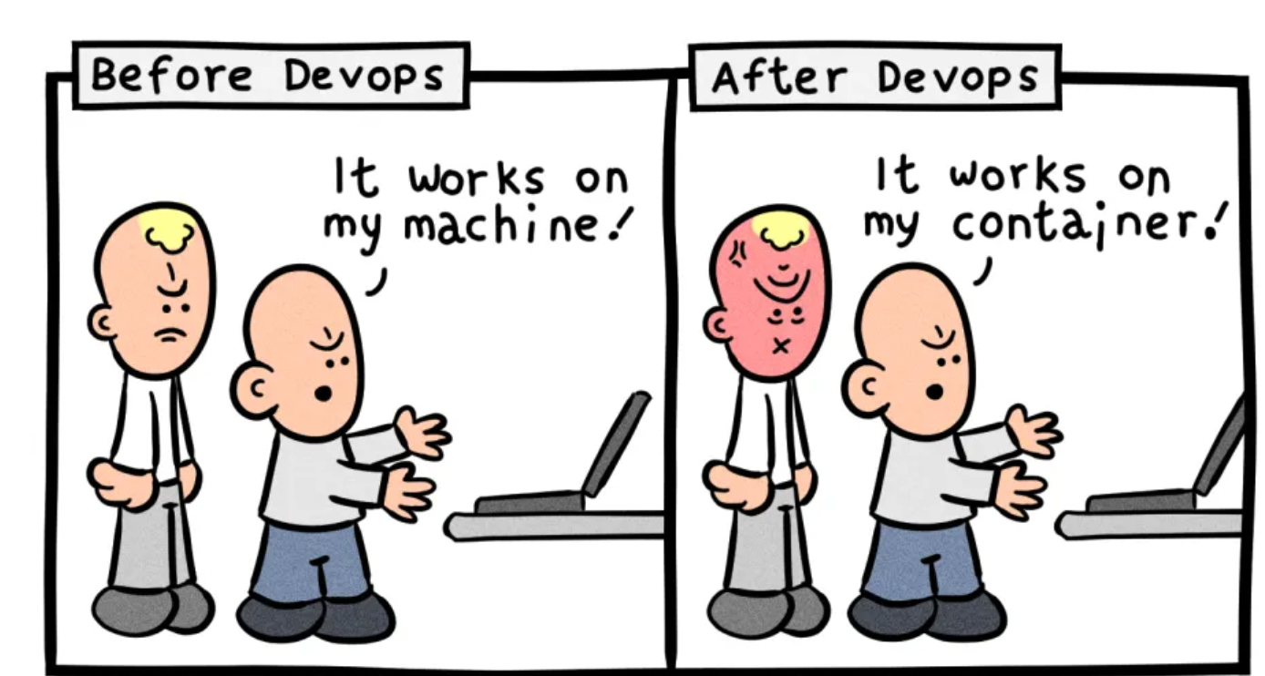
Earlier we have VM’s virtual machines but with them there were may problems

Slide 3
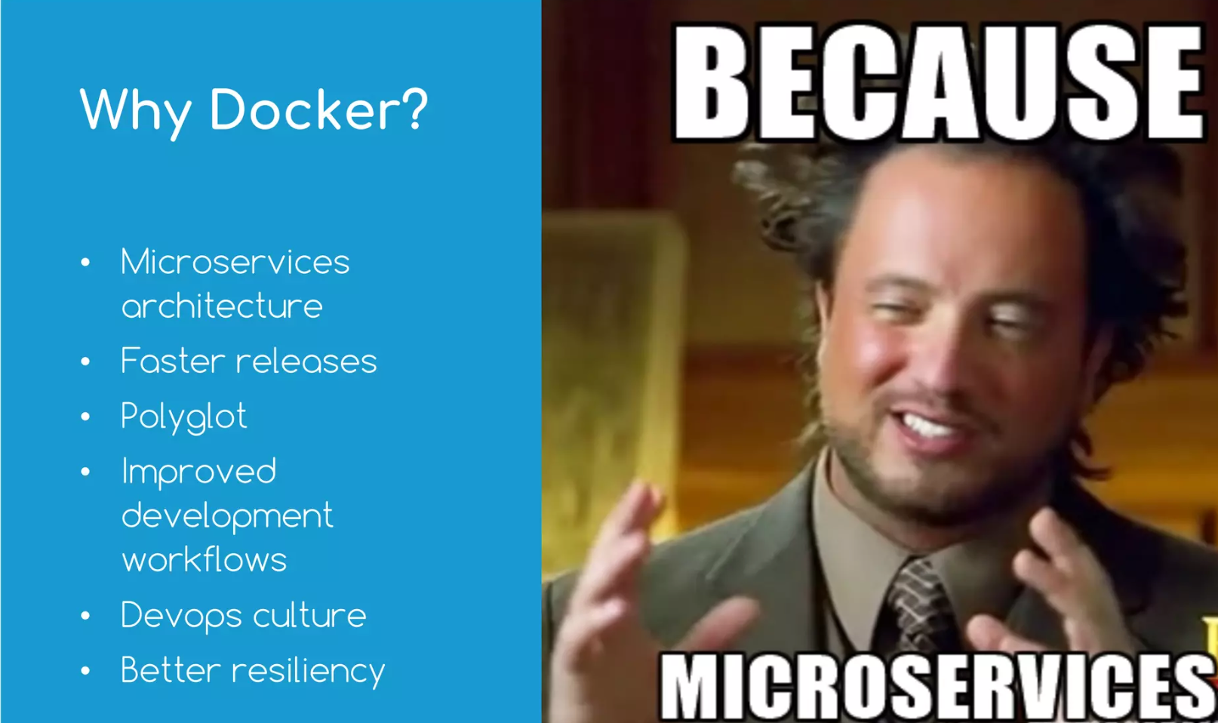
So Docker came into picture, which create container

Slide 4
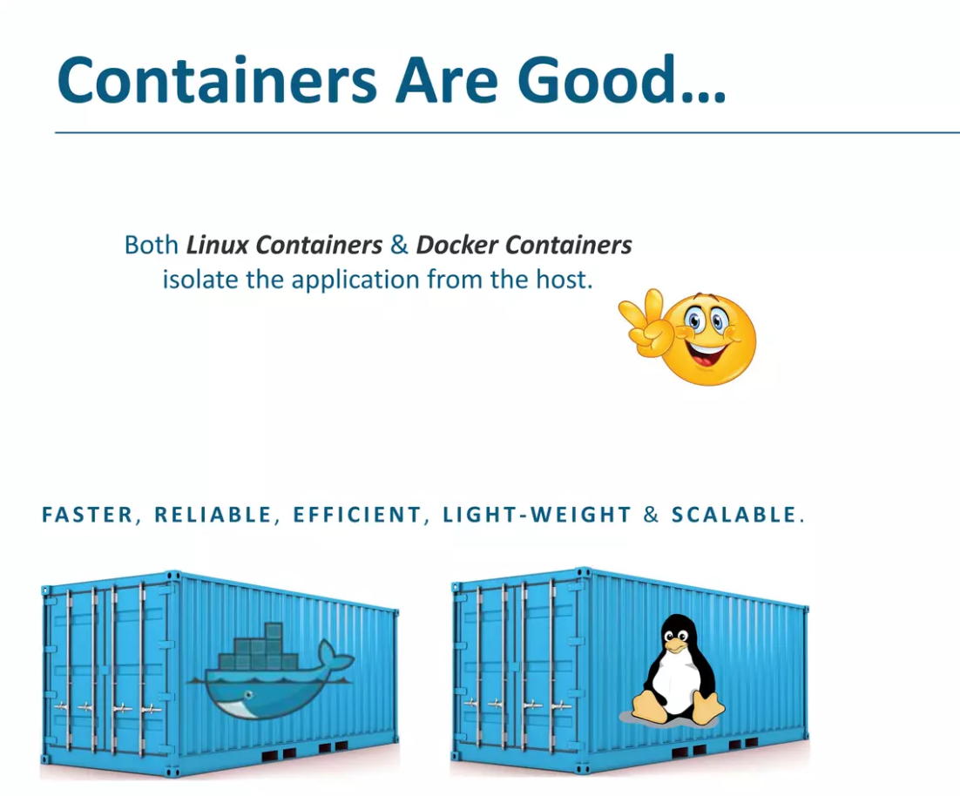

Slide 5
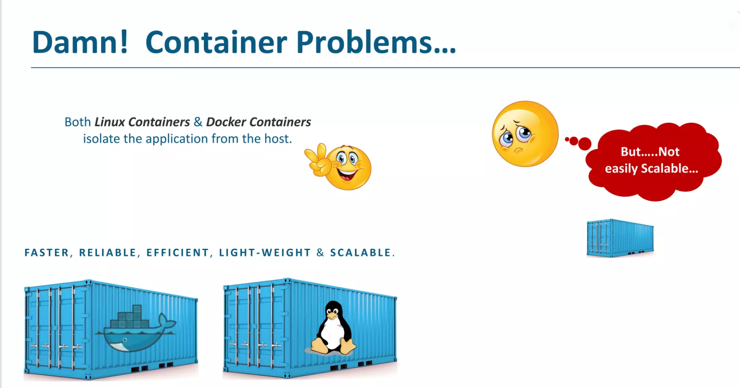

Slide 6
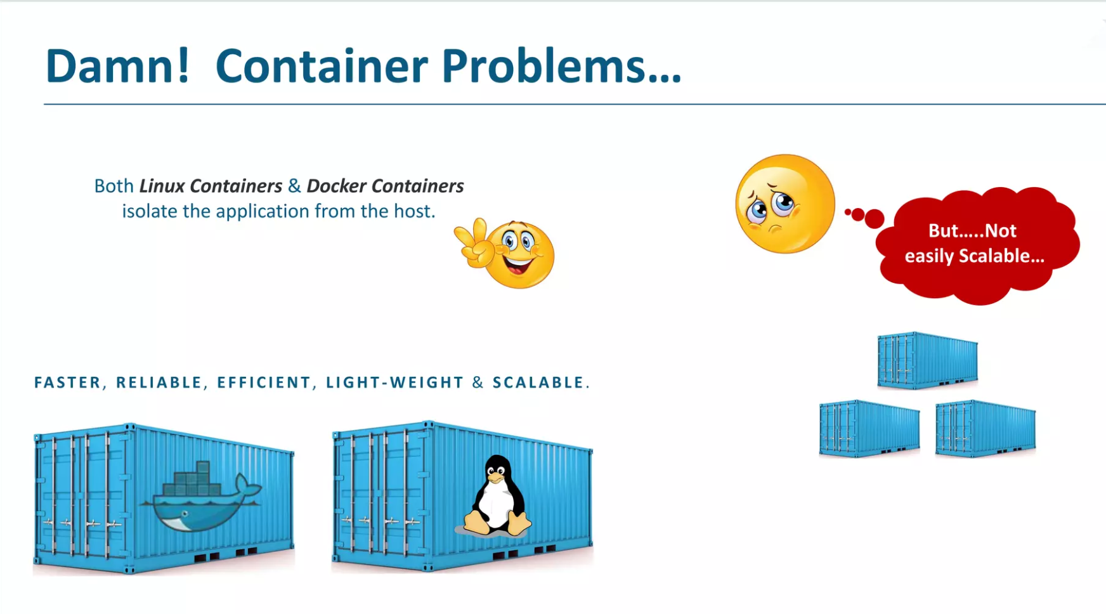

Slide 7
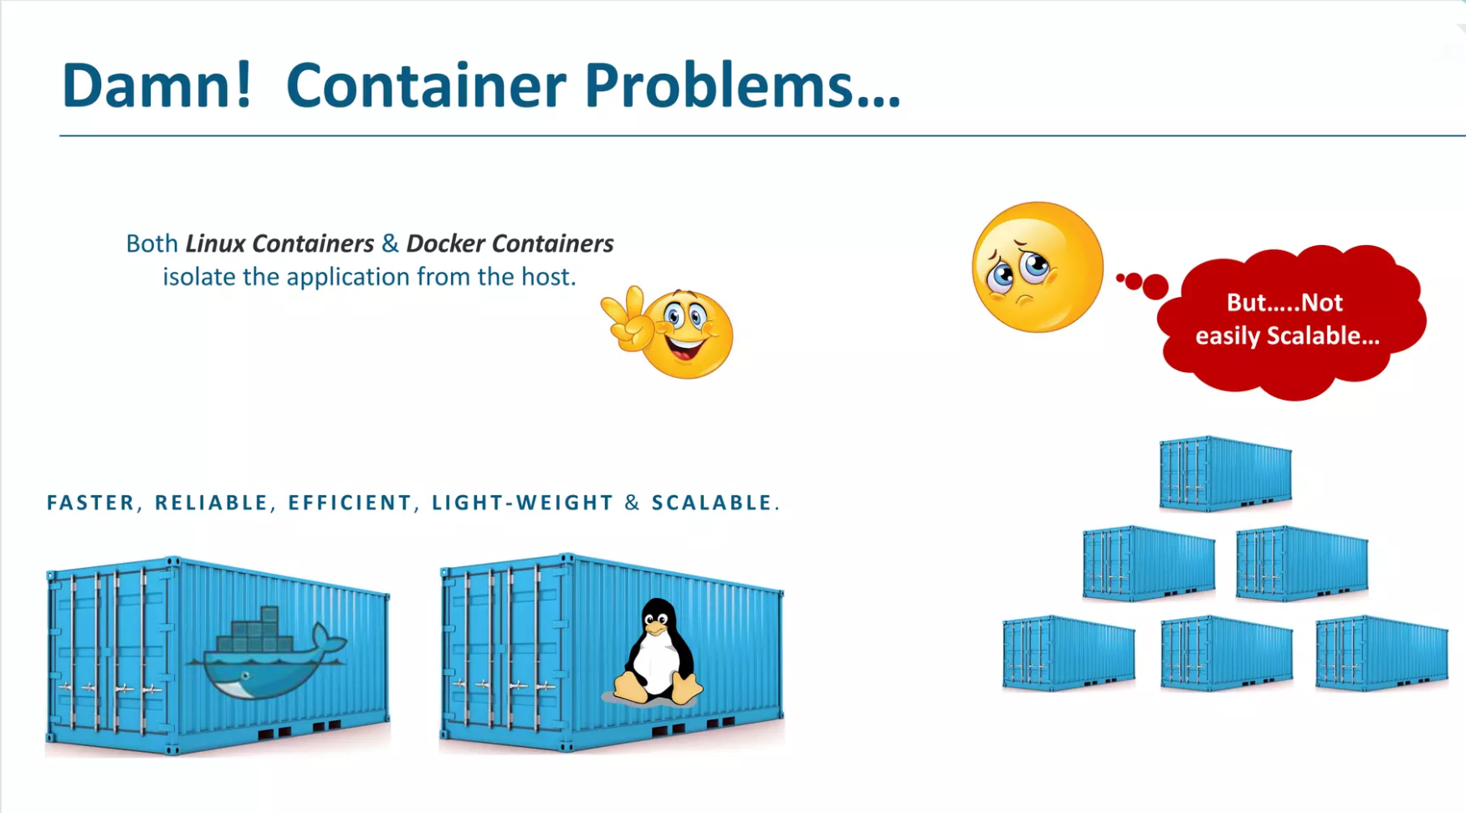

Slide 8
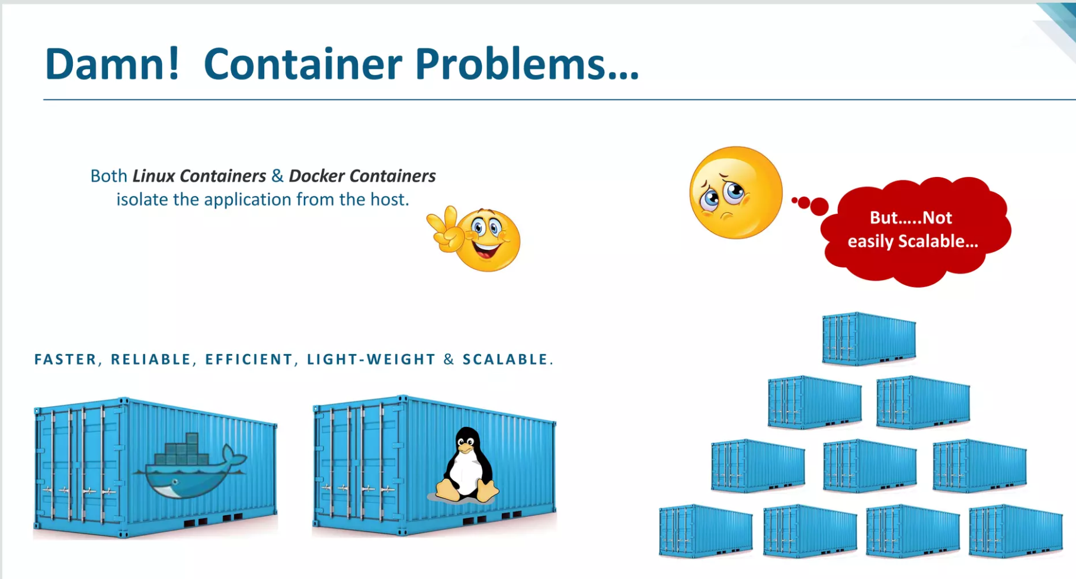

Slide 9
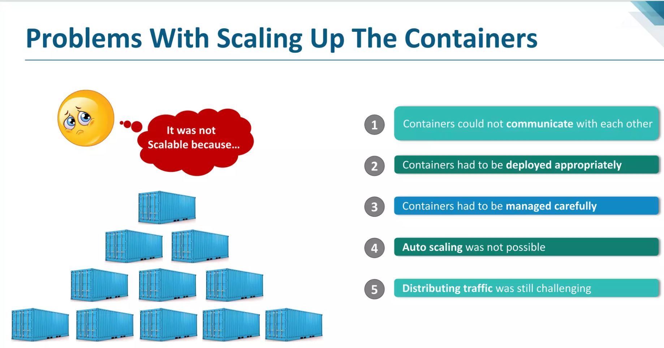

Slide 10
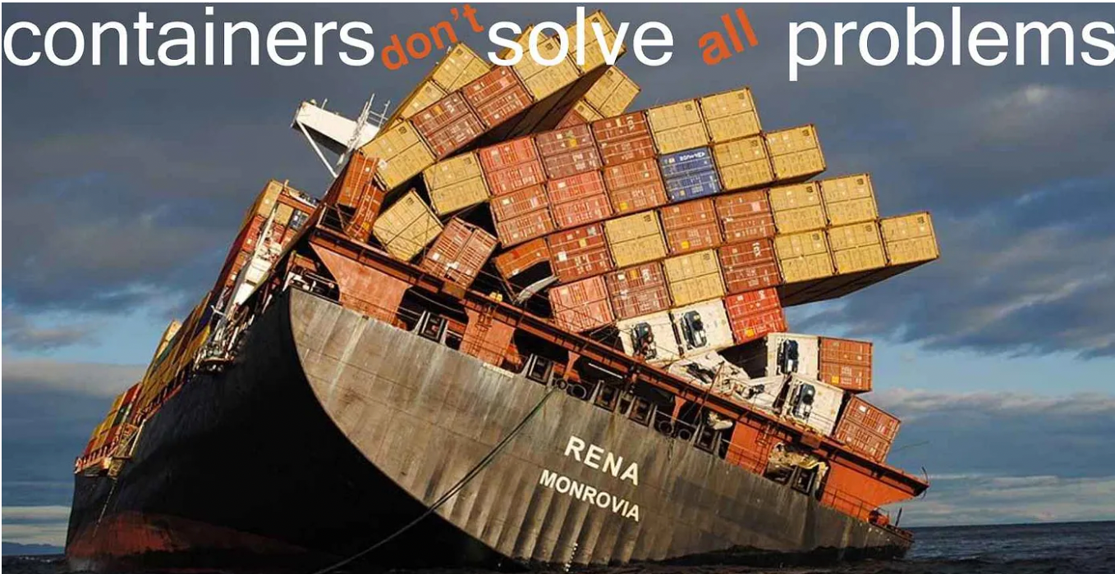
But

Slide 11


Slide 12
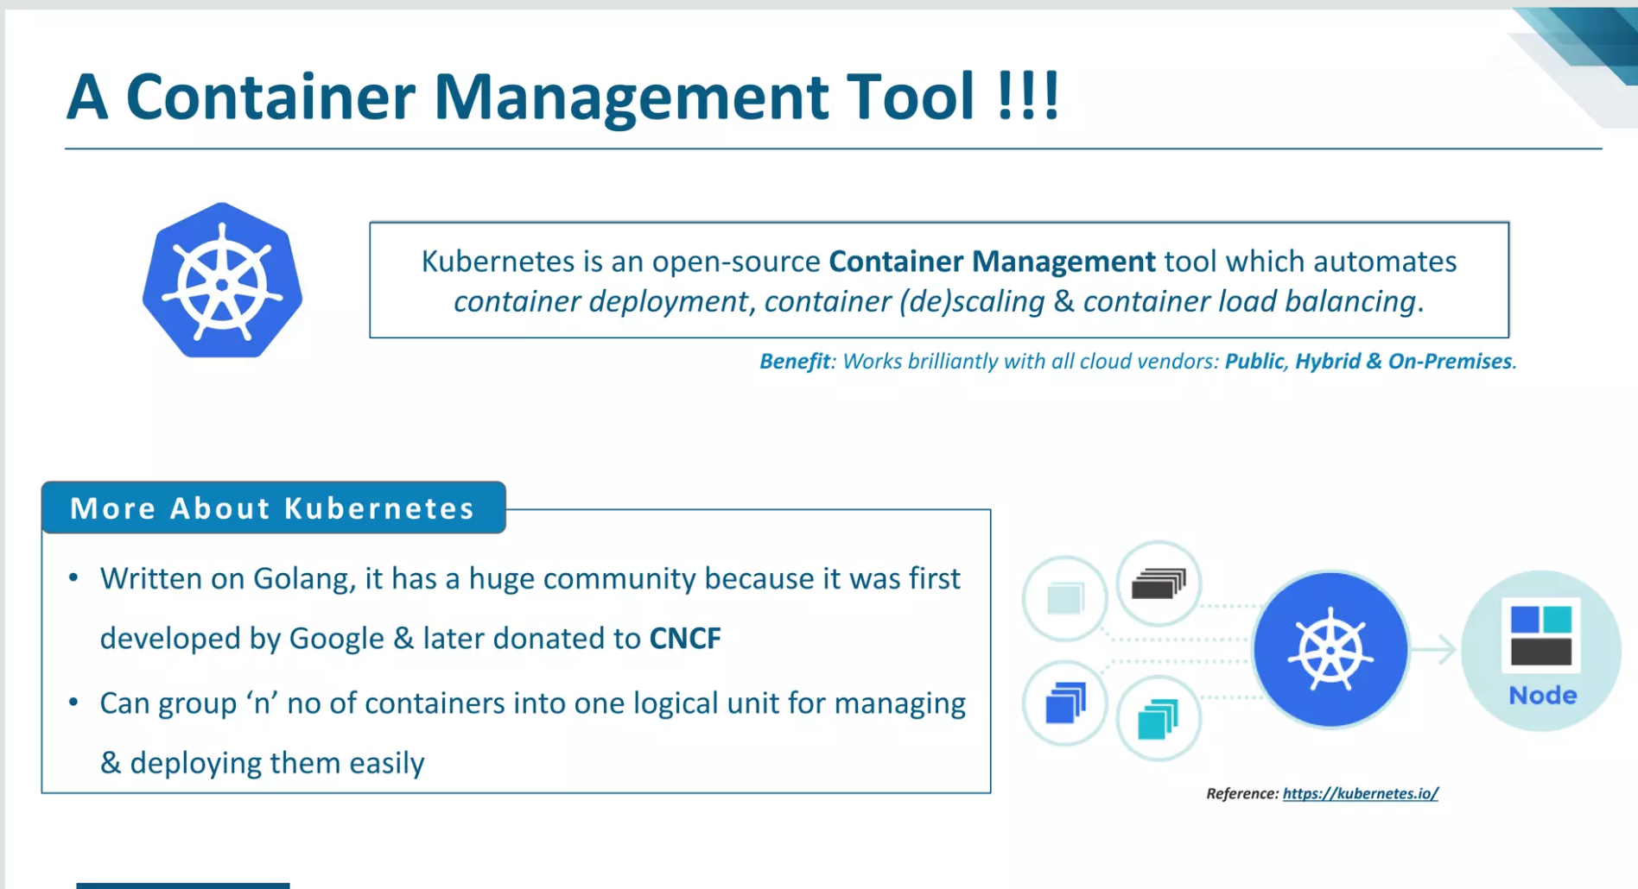
What is Kubernetes

Slide 13
We need someone to manage container then we have multiple options
Like 1st tool given by Docker i.e Docker swarm
2nd Kubernetes, created by Google and now its open sourced, they donated it
We use Kubernetes because it gives more functionalities and has UI

Slide 14
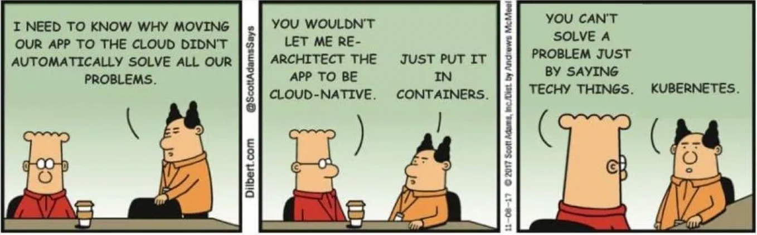
A guy Kubernetes which Says

Slide 15
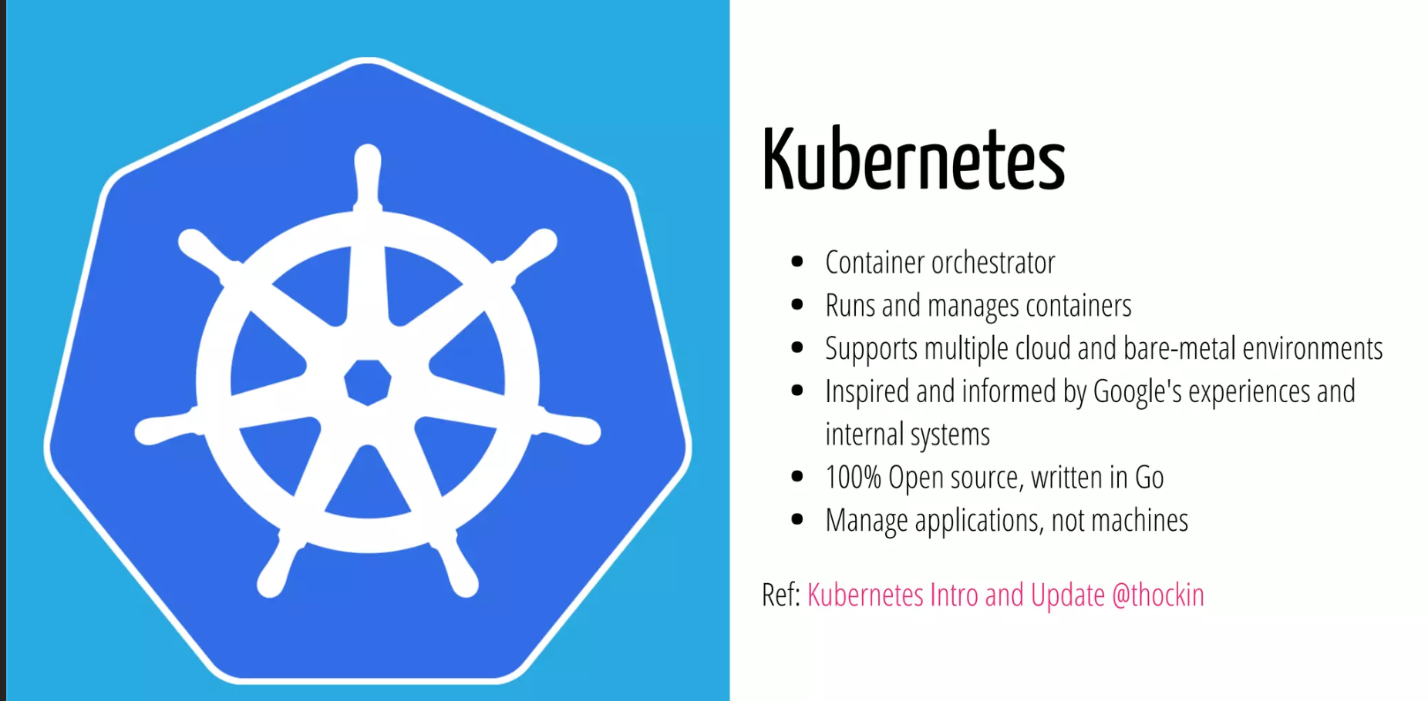
What Kubernetes does

Slide 16
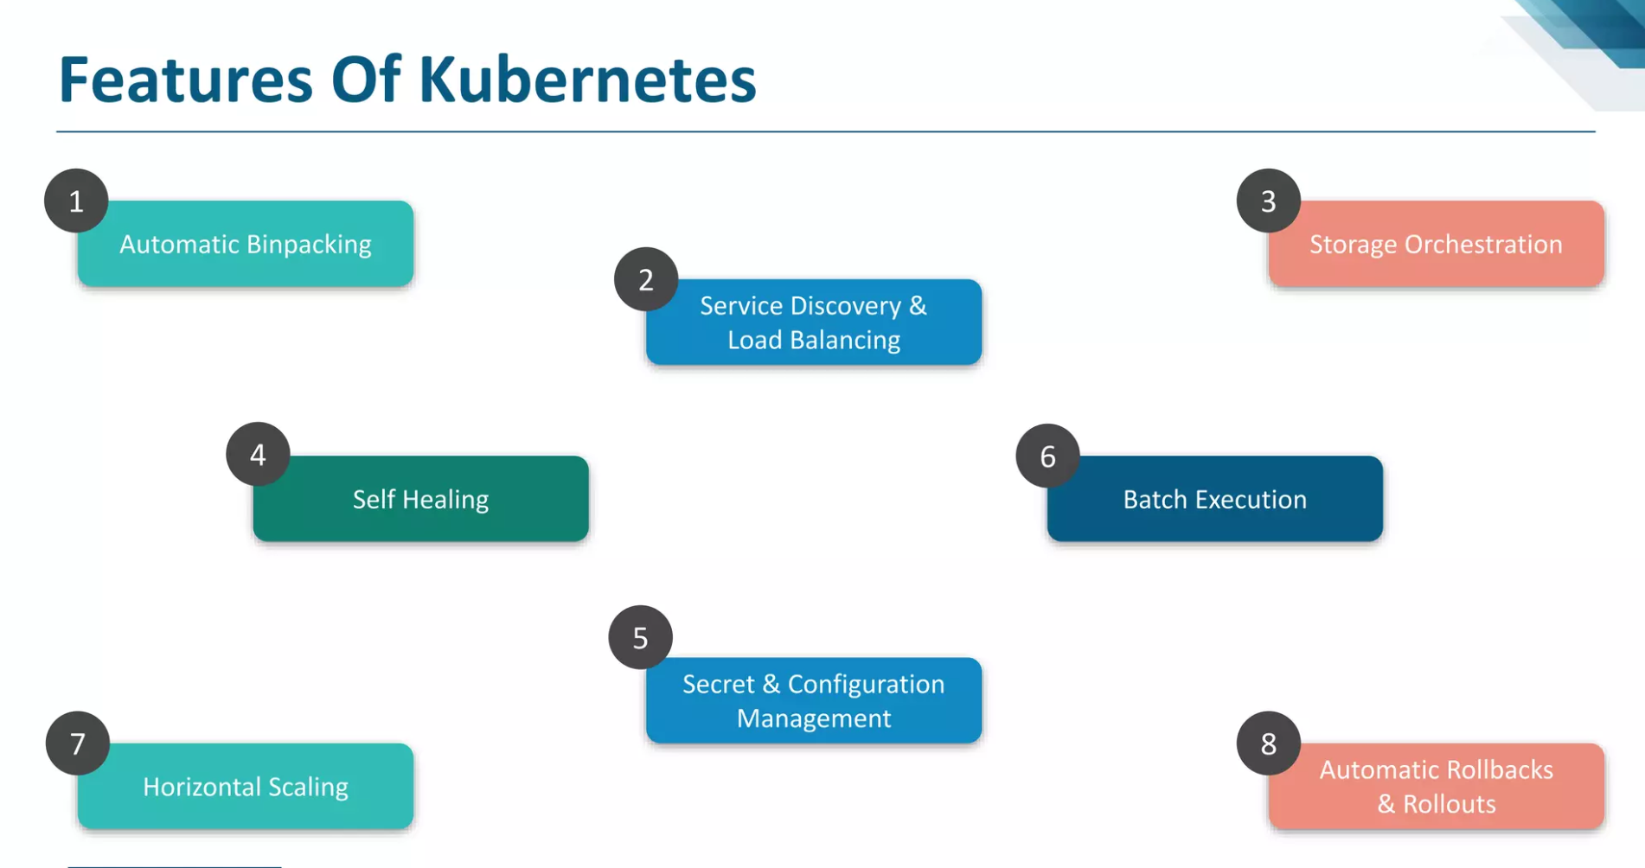

Slide 17
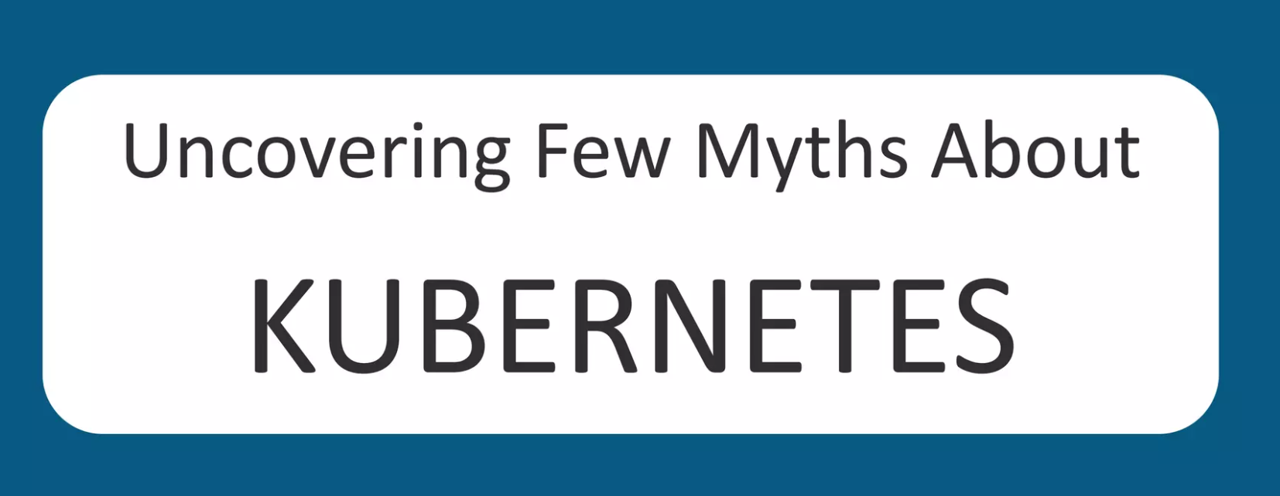

Slide 18
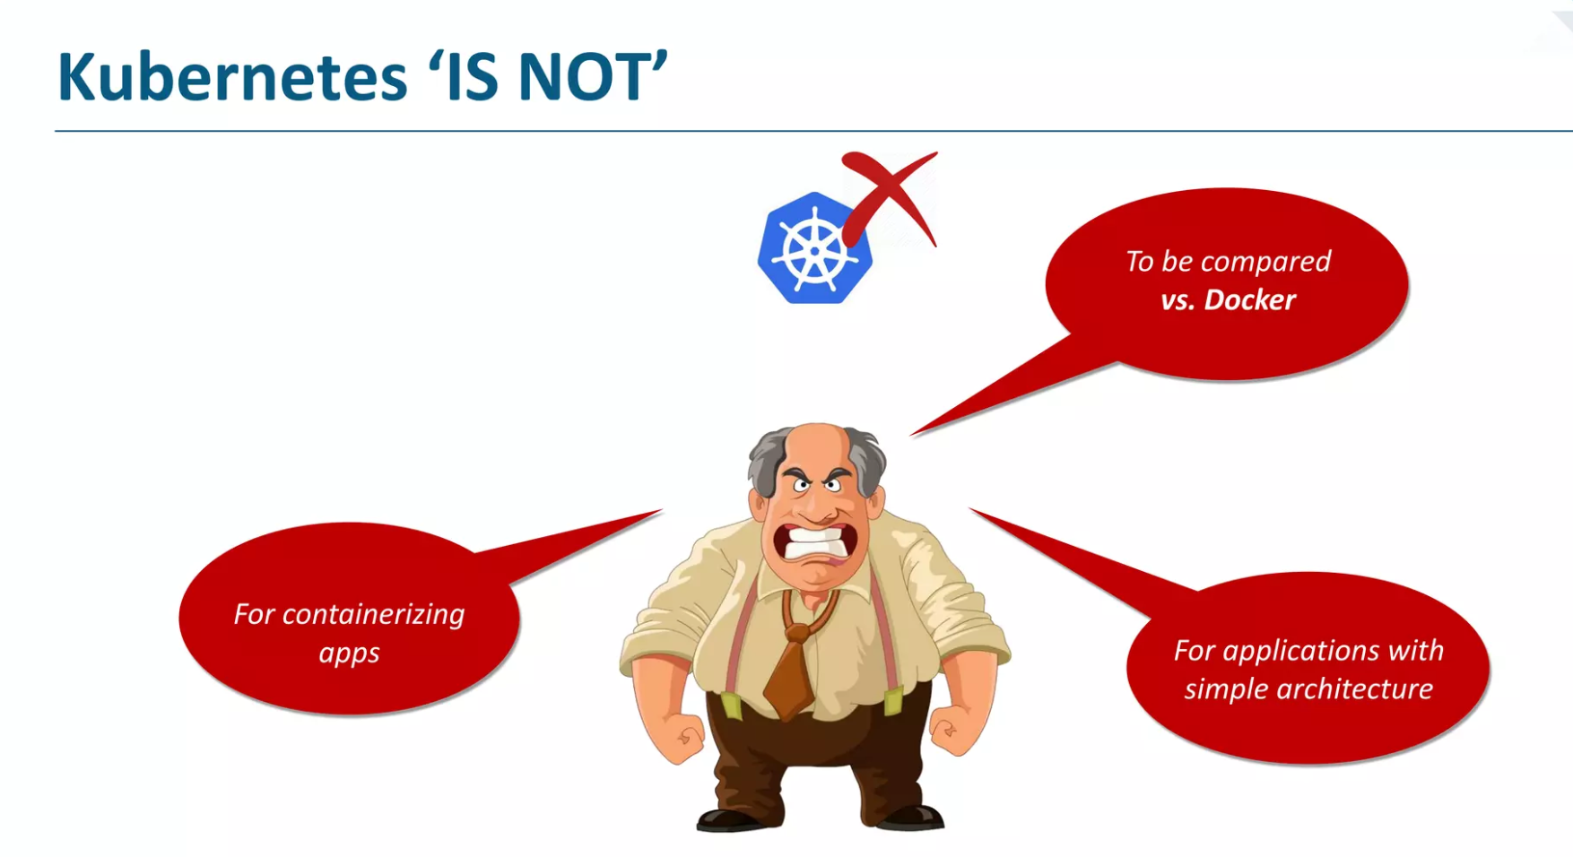

Slide 19
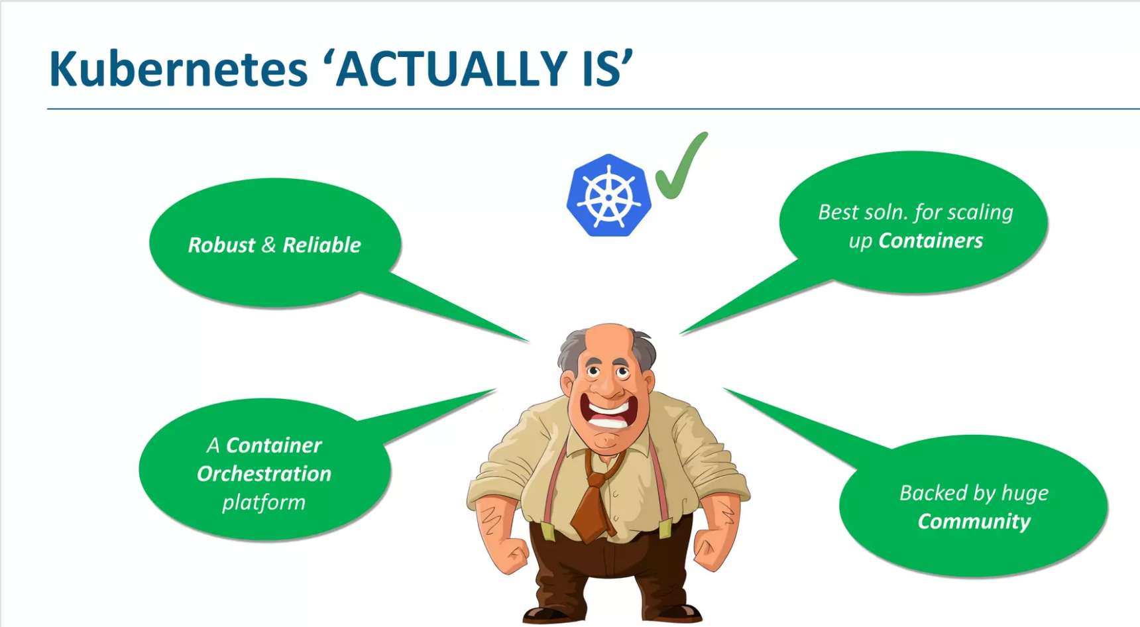

Slide 20
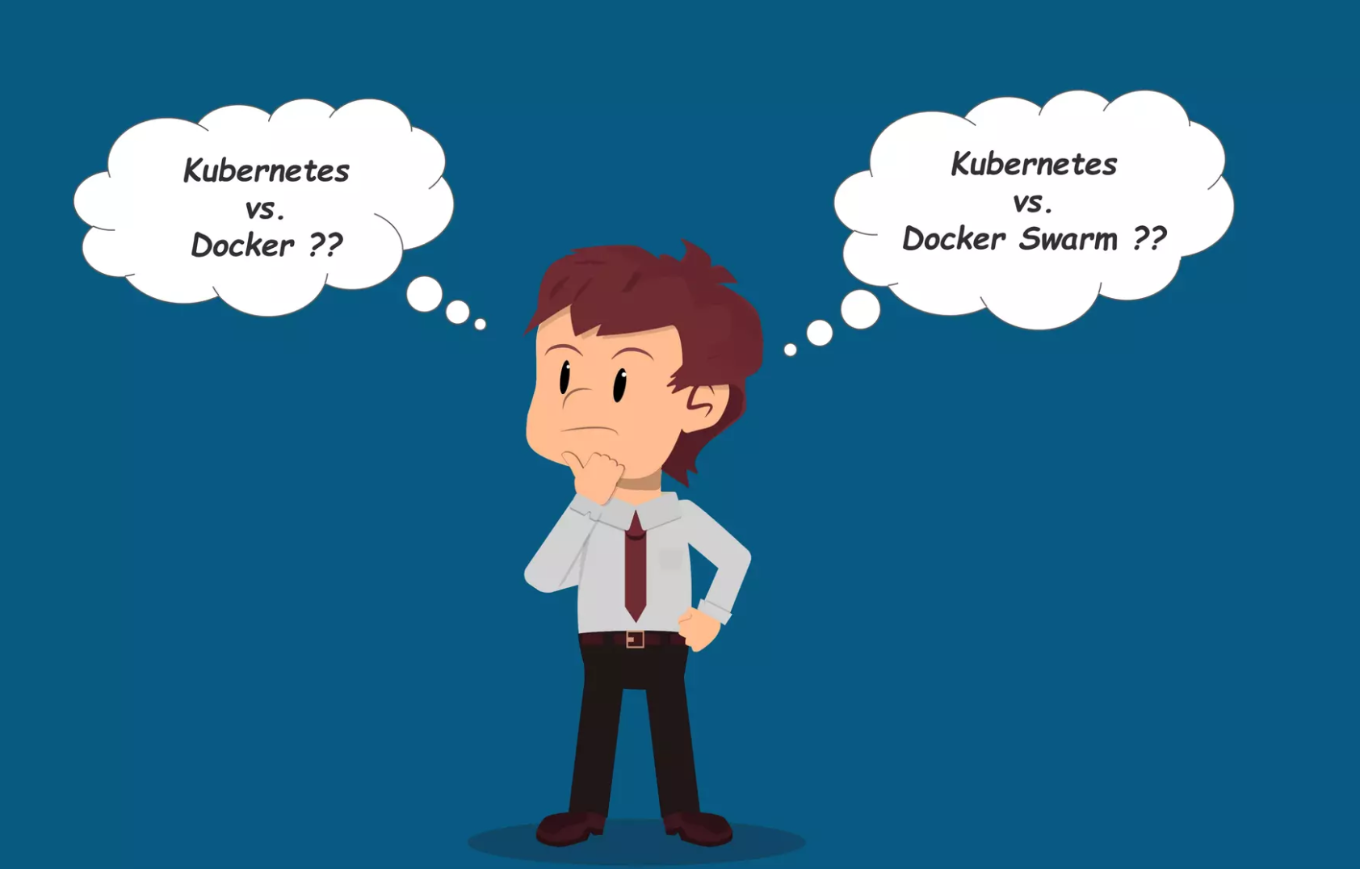

Slide 21
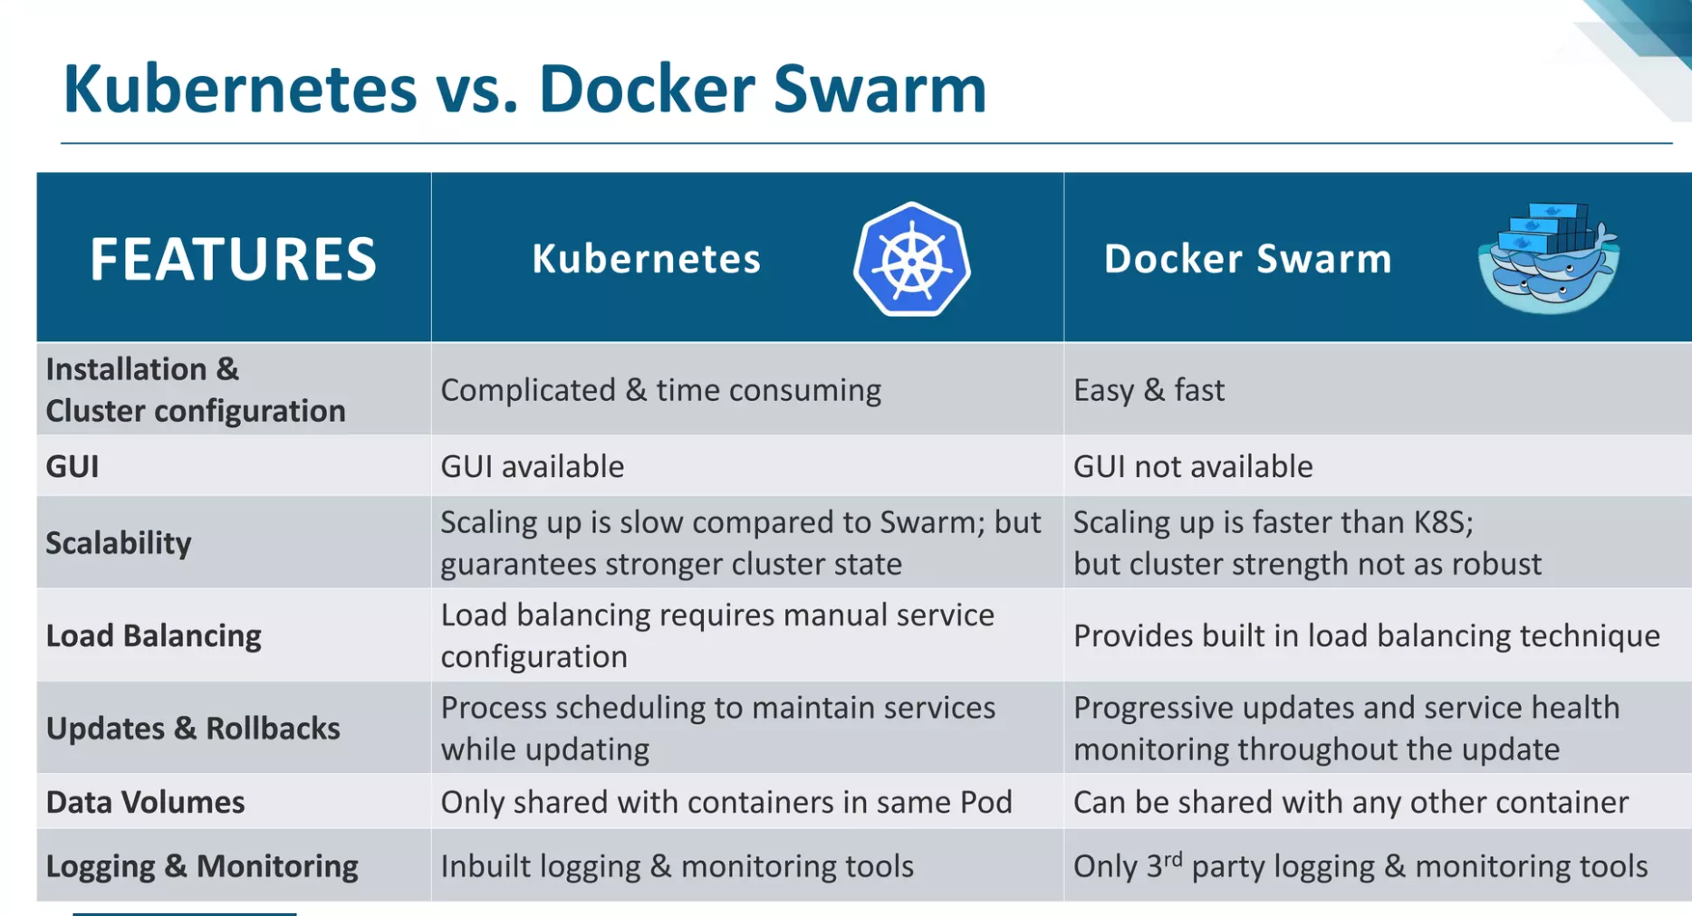

Slide 22
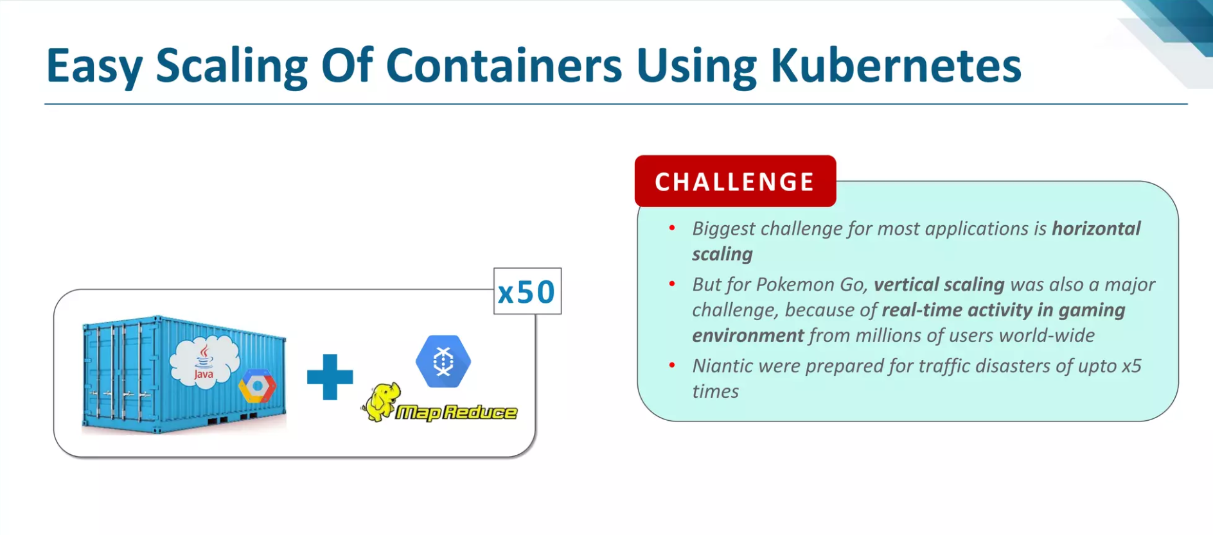

Slide 23
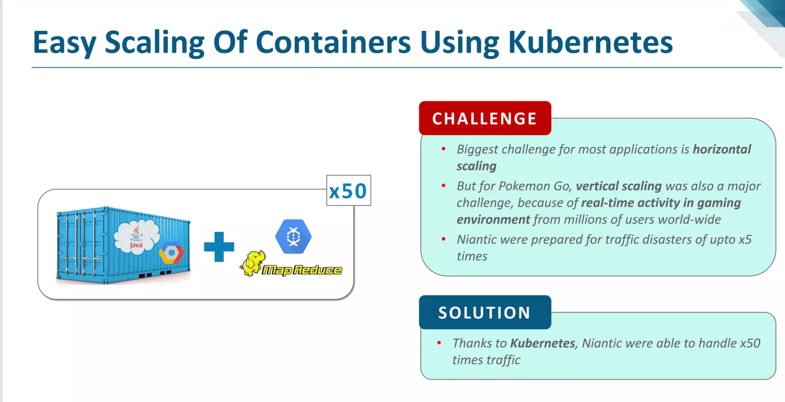

Slide 24
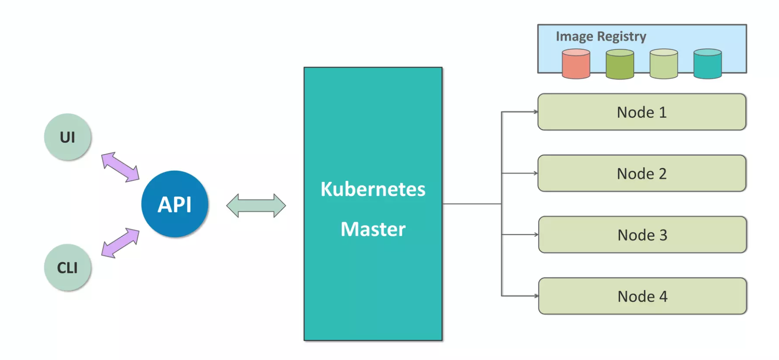
Architecture of Kubernetes

Slide 25
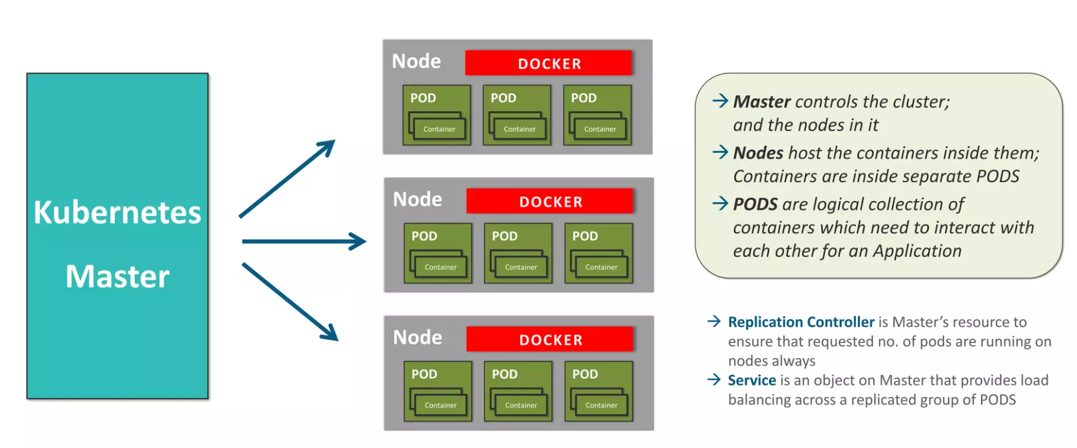
Working of Kubernetes

Slide 26
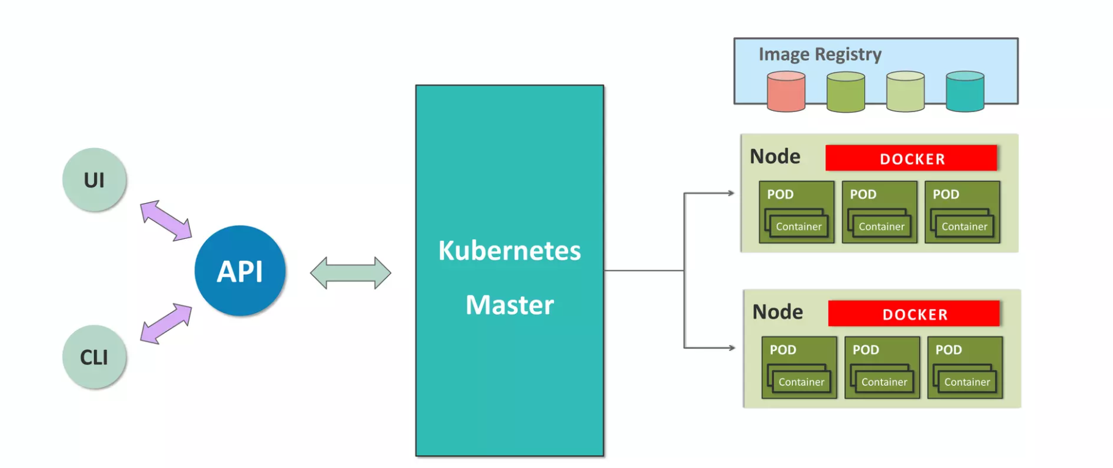

Slide 27
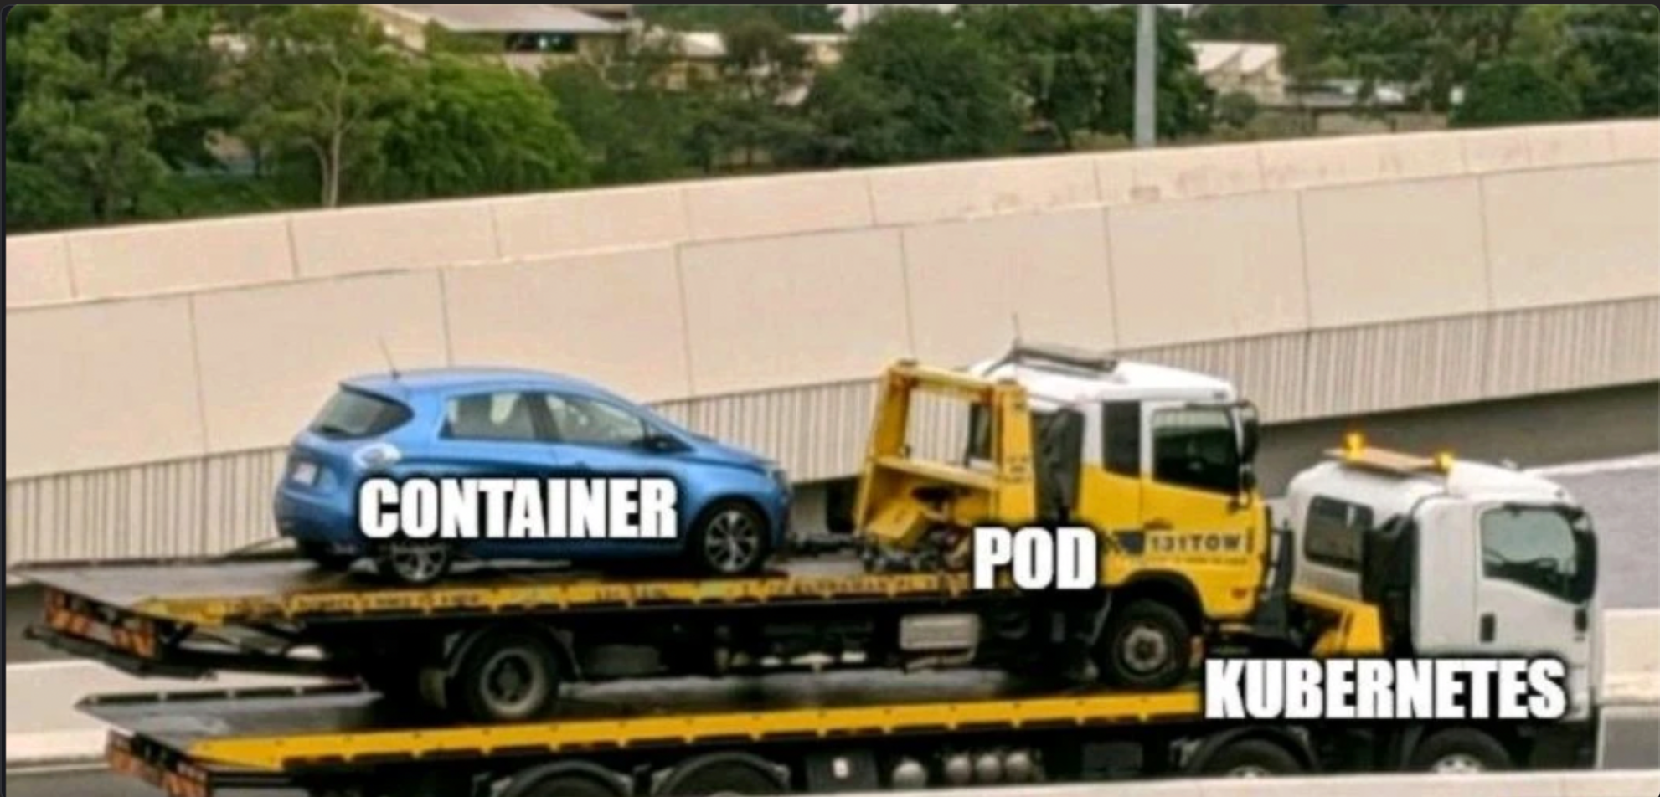

Slide 28
Some Concepts

